Slide 1


http://www.comp.nus.edu.sg/~cs2100/
Recitation 7
Boolean Algebra, Circuit Design, Simplification

Slide 2
Agenda
Help Sessions
Townhall
Quick Summary
Solutions to Rec7 Quizzes
Sli.Do Questions
Extra Questions

Slide 3
summary
Basics of Boolean Algebra

Slide 4
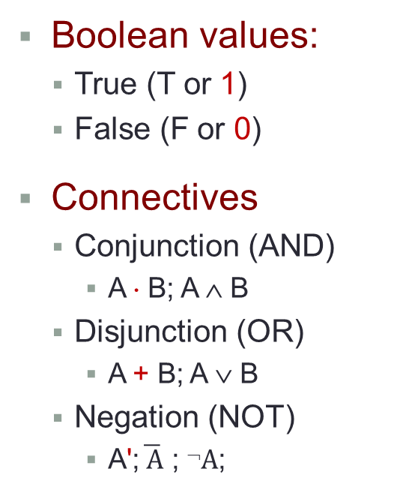
2. Boolean Algebra
Boolean values:
True (T or 1)
False (F or 0)
Connectives
Conjunction (AND)
A ⋅ B; A ∧ B
Disjunction (OR)
A + B; A ∨ B
Negation (NOT)
A';$\overline{ \text{A}}$ ; $➢\text{A}$;
Truth tables
Logic gates
A | B | A ⋅ B
0 | 0 | 0
0 | 1 | 0
1 | 0 | 0
1 | 1 | 1
A
B
A⋅B
A | B | A + B
0 | 0 | 0
0 | 1 | 1
1 | 0 | 1
1 | 1 | 1
A
B
A+B
In CS2100, we use the symbols 1 for true, 0 for false, ∙ for AND, + for OR, and ' for negation (you may use the accent bar). Please follow.
A | A'
0 | 1
1 | 0
A
A'

Slide 5
2. Boolean Algebra: AND
Do write the AND operator ∙ (instead of omitting it)
Example: Write a∙b instead of ab
Why? Writing ab could mean that it is a 2-bit value.

Slide 6
4. Precedence of Operators
Precedence from highest to lowest
Not (')
And (⋅)
Or (+)
Examples:
A ⋅ B + C = (A ⋅ B) + C
X + Y' = X + (Y')
P + Q' ⋅ R = P + ((Q') ⋅ R)
Use parenthesis to overwrite precedence. Examples:
A ⋅ (B + C) [ Without parenthesis, it means A⋅B+C or (A⋅B)+C ]
(P + Q)' ⋅ R [ Without parenthesis, it means P+Q'⋅R or P+(Q'⋅R) ]
Note the difference with CS1231/CS1231S. Here in CS2100, AND has higher precedence than OR.
Hence, A ⋅ B + C is not ambiguous in CS2100.

Slide 7
summary
Boolean Algebra Laws

Slide 8

6. Duality
If the AND/OR operators and identity elements 0/1 in a Boolean equation are interchanged, it remains valid.
Example:
The dual equation of a+(b⋅c)=(a+b)⋅(a+c) is a⋅(b+c)=(a⋅b)+(a⋅c).
Duality gives free theorems – “two for the price of one”, as a Boolean equation is logically equivalent to its dual. So, you prove one theorem and the other comes for free!
Examples:
If (x+y+z)' = x'⋅y'⋅z' is valid, then its dual (x⋅y⋅z)' = x'+y'+z' is also valid.
If x+1 = 1 is valid, then its dual x⋅0 = 0 is also valid.
Do not confuse duality with negation!

Slide 9
5. Laws of Boolean Algebra
Identity laws
A + 0 = 0 + A = A | A ⋅ 1 = 1 ⋅ A = A
Inverse/complement laws
A + A' = A' + A = 1 | A ⋅ A' = A' ⋅ A = 0
Commutative laws
A + B = B + A | A ⋅ B = B ⋅ A
Associative laws *
A + (B + C) = (A + B) + C | A ⋅ (B ⋅ C) = (A ⋅ B) ⋅ C
Distributive laws
A ⋅ (B + C) = (A ⋅ B) + (A ⋅ C) | A + (B ⋅ C) = (A + B) ⋅ (A + C)
* Due to the associative laws, A + B + C is unambiguous. It may be evaluated as A + (B + C) or (A + B) + C. Likewise for A⋅B⋅C.

Slide 10
7. Theorems
Idempotency
X + X = X | X ⋅ X = X
One element / Zero element
X + 1 = 1 + X = 1 | X ⋅ 0 = 0 ⋅ X = 0
Involution
( X' )' = X
Absorption 1
X + X⋅Y = X | X⋅(X + Y) = X
Absorption 2
X + X'⋅Y = X + Y | X⋅(X' + Y) = X⋅Y
DeMorgans’ (can be generalised to more than 2 variables)
(X + Y)' = X' ⋅ Y' | (X ⋅ Y)' = X' + Y'
Consensus
X⋅Y + X'⋅Z + Y⋅Z = X⋅Y + X'⋅Z | (X+Y)⋅(X'+Z)⋅(Y+Z) = (X+Y)⋅(X'+Z)

Slide 11
summary
SOP, POS, Minterms, Maxterms

Slide 12
10. Standard Forms (2/2)
Sum term
A single literal or a logical sum (OR) of several literals
Examples: (1) x, (2) x+y+z', (3) A'+B, (4) A+B, (5) c+d+h'+j
Sum-of-Products (SOP) expression
A product term or a logical sum (OR) of several product terms
Examples: (1) x, (2) x + y⋅z', (3) x⋅y' + x'⋅y⋅z, (4) A⋅B + A'⋅B', (5) A + B'⋅C + A⋅C' + C⋅D
Product-of-Sums (POS) expression
A sum term or a logical product (AND) of several sum terms
Examples: (1) x, (2) x⋅(y+z'), (3) (x+y')⋅(x'+y+z), (4) (A+B)⋅(A'+B'), (5) (A+B+C)⋅D'⋅(B'+D+E')
Every Boolean expression can be expressed in SOP or POS form.
DLD page 59 Quick Review Questions Questions 3-2 to 3-5.

Slide 13
11. Minterms and Maxterms (1/2)
A minterm of n variables is a product term that contains n literals from all the variables.
Example: On 2 variables x and y, the minterms are:
x'∙y', x'∙y, x∙y' and x∙y
A maxterm of n variables is a sum term that contains n literals from all the variables.
Example: On 2 variables x and y, the maxterms are:
x'+y', x'+y, x+y' and x+y
In general, with n variables we have up to 2^{n} minterms and 2^{n} maxterms.

Slide 14
11. Minterms and Maxterms (2/2)
The minterms and maxterms on 2 variables are denoted by m0 to m3 and M0 to M3 respectively.
x | y | Minterms |  | Maxterms
 |  | Term | Notation | Term | Notation
0 | 0 | x'∙y' | m0 | x+y | M0
0 | 1 | x'∙y | m1 | x+y' | M1
1 | 0 | x∙y' | m2 | x'+y | M2
1 | 1 | x∙y | m3 | x'+y' | M3
Important fact: Each minterm is the complement of its corresponding maxterm. Likwise, each maxterm is the complement of its corresponding minterm.
Example: m2 = x∙y' m2' = ( x∙y' )' = x' + ( y' )' = x' + y = M2

Slide 15
12.1 Sum-of-Minterms
Given a truth table, example:
x | y | z | F1 | F2 | F3
0 | 0 | 0 | 0 | 0 | 0
0 | 0 | 1 | 0 | 1 | 1
0 | 1 | 0 | 0 | 0 | 0
0 | 1 | 1 | 0 | 0 | 1
1 | 0 | 0 | 0 | 1 | 1
1 | 0 | 1 | 0 | 1 | 1
1 | 1 | 0 | 1 | 1 | 0
1 | 1 | 1 | 0 | 1 | 0
Obtain sum-of-minterms expression by gathering the minterms of the function (where output is 1).
F1 = x∙y∙z' = m6
F2 = x'∙y'∙z + x∙y'∙z' + x∙y'∙z + x∙y∙z' + x∙y∙z = m1 + m4 + m5 + m6 + m7 = Σm(1,4,5,6,7) or Σm(1,4 – 7)
F3 = x'∙y'∙z + x'∙y∙z + x∙y'∙z' + x∙y'∙z = m1 + m3 + m4 + m5 = Σm(1,3,4,5) or Σm(1,3 – 5)


Slide 16
12.2 Product-of-Maxterms
Given a truth table, example:
x | y | z | F1 | F2 | F3
0 | 0 | 0 | 0 | 0 | 0
0 | 0 | 1 | 0 | 1 | 1
0 | 1 | 0 | 0 | 0 | 0
0 | 1 | 1 | 0 | 0 | 1
1 | 0 | 0 | 0 | 1 | 1
1 | 0 | 1 | 0 | 1 | 1
1 | 1 | 0 | 1 | 1 | 0
1 | 1 | 1 | 0 | 1 | 0
Obtain product-of-maxterms expression by gathering the maxterms of the function (where output is 0).
F2 = (x+y+z) ∙ (x+y'+z) ∙ (x+y'+z') = M0 ∙ M2 ∙ M3 = ΠM(0,2,3)
F3 = (x+y+z) ∙ (x+y'+z) ∙ (x'+y'+z) ∙ (x'+y'+z') = M0 ∙ M2 ∙ M6 ∙ M7 = ΠM(0,2,6,7)


Slide 17
12.3 Conversion of Standard Forms
We can convert between sum-of-minterms and product-of-maxterms easily
Example: F2 = Σm(1,4,5,6,7) = ΠM(0,2,3)
Why? See F2' in truth table.
x | y | z | F2 | F2'
0 | 0 | 0 | 0 | 1
0 | 0 | 1 | 1 | 0
0 | 1 | 0 | 0 | 1
0 | 1 | 1 | 0 | 1
1 | 0 | 0 | 1 | 0
1 | 0 | 1 | 1 | 0
1 | 1 | 0 | 1 | 0
1 | 1 | 1 | 1 | 0
F2' = m0 + m2 + m3 Therefore, F2 = (m0 + m2 + m3)' = m0' ∙ m2' ∙ m3' (by DeMorgan’s) = M0 ∙ M2 ∙ M3 (as mx' = Mx)
Read up DLD section 3.4, pg 57 – 58.
Quick Review Questions: pg 60 – 61, Q3-6 to 3-13.

Slide 18
summary
Basics of Digital Circuits

Slide 19
1.1 Inverter/AND/OR Gates
Inverter (NOT gate)
A | A'
0 | 1
1 | 0
A
A'
A
A'
AND gate
OR gate
A
B
A
B
A ⋅ B
A+B
A | B | A ⋅ B
0 | 0 | 0
0 | 1 | 0
1 | 0 | 0
1 | 1 | 1
A | B | A + B
0 | 0 | 0
0 | 1 | 1
1 | 0 | 1
1 | 1 | 1

Slide 20
1.2 NAND/NOR Gates
NAND gate
≡
A
B
(A ⋅ B)'
A
B
(A ⋅ B)'
A | B | (A ⋅ B)'
0 | 0 | 1
0 | 1 | 1
1 | 0 | 1
1 | 1 | 0
≡
NAND
Negative-OR
NOR gate
A
B
≡
A
B
(A + B)'
(A + B)'
A | B | (A + B)'
0 | 0 | 1
0 | 1 | 0
1 | 0 | 0
1 | 1 | 0
≡
NOR
Negative-AND


Slide 21
1.3 XOR/XNOR Gates
XOR gate
A | B | A ⊕ B
0 | 0 | 0
0 | 1 | 1
1 | 0 | 1
1 | 1 | 0
A
B
A ⊕ B
XNOR gate
A | B | (A ⊕ B)'
0 | 0 | 1
0 | 1 | 0
1 | 0 | 0
1 | 1 | 1
A
B
(A ⊕ B)'
XNOR can be represented by  (Example: A  B)


Slide 22
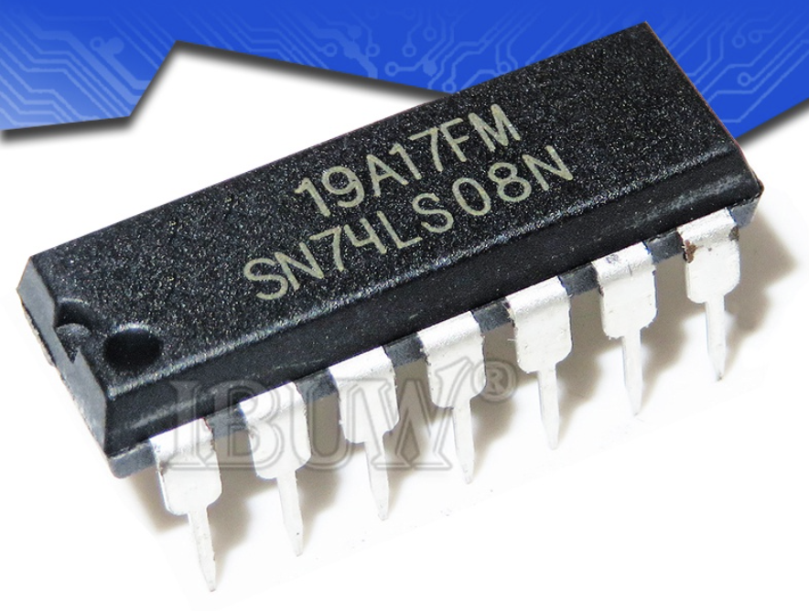
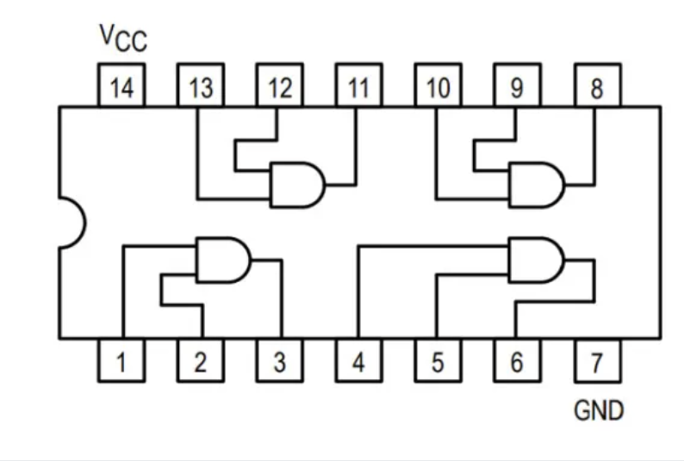
Logic Chips
NOT: 74LS04
2-input AND: 74LS08
2-input OR: 74LS32
2-input NAND: 74LS00
2-input NOR: 74LS02

Slide 23
summary
Analyzing Logic Circuits

Slide 24
2.1 Analysing Logic Circuits
Given a logic circuit, we can analyse it to obtain the logic expression.
Example: Given the logic circuit below, what is the Boolean expression of F4?
A
B
C
A'⋅B'
(A'⋅B')+C
((A'⋅B')+C)'
F4
F4 = ((A'⋅B')+C)' = (A+B)⋅C'
DLD page79 Quick Review Questions Questions 4-1 to 4-4.


Slide 25
summary
Universal Gates

Slide 26
3.3 SOP and NAND Circuits (2/2)
Example: F = A⋅B + C'⋅D + E
Using 2-level NAND circuit
A
A
B
B
C
C
F
F
D
D
E
E
A
B
C
F
D
E

Slide 27
3.4 POS and NOR Circuits (2/2)
Example: G = (A+B) ⋅ (C'+D) ⋅ E
Using 2-level NOR circuit
A
A
B
B
C
C
D
G
D
G
E
E
A
B
C
D
G
E

Slide 28
summary
K-Maps

Slide 29
5.1 4-Variable K-maps (1/2)
There are 16 square cells in a 4-variable K-map.
Example: Let the variables be w, x, y, z.
y
yz
wx
00 01 11 10
00
01
11
10
m0
m1
m3
m2
m4
m5
m7
m6
x
m12
m13
m15
m14
w
m8
m9
m11
m10
z

Slide 30
Drawing a K-Map from Scratch

Slide 31
5.2 How to Use K-maps (1/7)
Based on the Unifying Theorem (complement law):
A + A' = 1
In a K-map, each cell containing a ‘1’ corresponds to a minterm of a given function F where the output is 1.
Each valid grouping of adjacent cells containing ‘1’ then corresponds to a simpler product term of F.
A group must have size in powers of two: 1, 2, 4, 8, …
Grouping 2 adjacent cells eliminates 1 variable from the product term; grouping 4 cells eliminates 2 variables; grouping 8 cells eliminates 3 variables, and so on. In general, grouping 2^{n} cells eliminates n variables.

Slide 32
5.2 How to Use K-maps (2/7)
Group as many cells as possible
The larger the group, the fewer the number of literals in the resulting product term.
Select as few groups as possible to cover all the cells (minterms) of the function
The fewer the groups, the fewer is the number of product terms in the simplified SOP expression.

Slide 33
5.2 How to Use K-maps (3/7)
Example:
F (w,x,y,z) = w'∙x∙y'∙z' + w'∙x∙y'∙z + w∙x'∙y∙z'
+ w∙x'∙y∙z + w∙x∙y∙z' + w∙x∙y∙z
= Σ m(4, 5, 10, 11, 14, 15)
y
yz
wx
00 01 11 10
00
01
11
10
0
0
0
0
1
1
0
0
x
0
0
1
1
w
0
0
1
1
z

Slide 34
5.6 Finding Simplified POS Expression (1/2)
Simplified POS expression can be obtained by grouping the maxterms (i.e. 0s) of the given function.
Example:
Given F = Σm(0,1,2,3,5,7,8,9,10,11), we first draw the K-map, then group the maxterms together:
A
AB
CD
00 01 11 10
00
01
11
10
1
0
0
1
1
1
0
1
D
1
1
0
1
C
1
0
0
1
B

Slide 35
5.6 Finding Simplified POS Expression (2/2)
A
A
AB
AB
CD
00 01 11 10
CD
00 01 11 10
K-map of F
00
01
11
10
1
0
0
1
00
01
11
10
0
1
1
0
K-map of F'
1
1
0
1
0
0
1
0
D
D
1
1
0
1
0
0
1
0
C
C
1
0
0
1
0
1
1
0
B
B
This gives the SOP of F' to be F' = B⋅D' + A⋅B
To get POS of F, we have
F = (B⋅D' + A⋅B)' = (B⋅D')' ⋅ (A⋅B)' (DeMorgan) = (B'+D) ⋅ (A'+B') (DeMorgan)


Slide 36
5.2 How to Use K-maps (7/7)
Examples of valid and invalid groupings.
1
1
1
1
1
1
1
1
1
1
1
1
1
1
1
1
1
1
1
1
P
P
P
1
1
1
1
1
1
1
1
1
1
1
1
1
1
O
1
1
O

Slide 37
summary
Prime Implicants, Essential Prime Implicants

Slide 38
5.4 PIs and EPIs (1/3)
To find the simplest (minimal) SOP expression from a K-map, you need to obtain:
Minimum number of literals per product term; and
Minimum number of product terms.
Achieved through K-map using
Bigger groupings of minterms (prime implicants) where possible; and
No redundant groupings (look for essential prime implicants)
Implicant: a product term that could be used to cover minterms of the function.

Slide 39
5.4 PIs and EPIs (2/3)
Prime implicant (PI): a product term obtained by combining the maximum possible number of minterms from adjacent squares in the map. (That is, it is the biggest grouping possible.)
Always look for prime implicants in a K-map.
1
1
1
1
1
1
1
1
1
O
1
1
1
P

Slide 40
5.4 PIs and EPIs (3/3)
No redundant groups:
1
1
1
1
1
1
O
1
1
P
1
1
1
1
1
1
1
1
Essential prime implicants
Essential prime implicant (EPI): a prime implicant that includes at least one minterm that is not covered by any other prime implicant.

Slide 41
quizzes

Slide 42
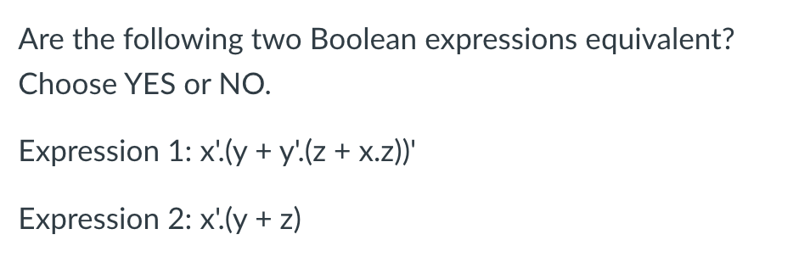
x’.(y + y’.(z + x.z))’
= x’.(y + y’.z)’ (Absorption 1)
= x’.(y + z)’ (Absorption 2)
!= (x’.(y + z))
NO, they are not equivalent!

Slide 43
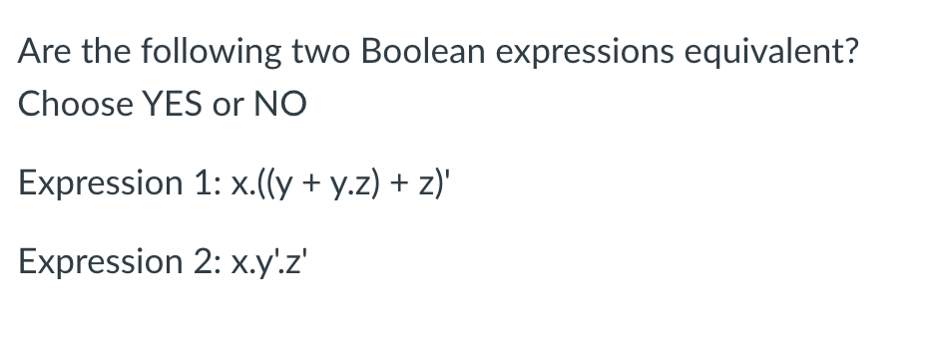
x.((y + y.z) + z)’
= x.(y + z)’ (Absorption 1)
= x.(y’.z’) (De-Morgan’s)
= x.y’.z’ (Associative)
YES, they are equivalent!

Slide 44
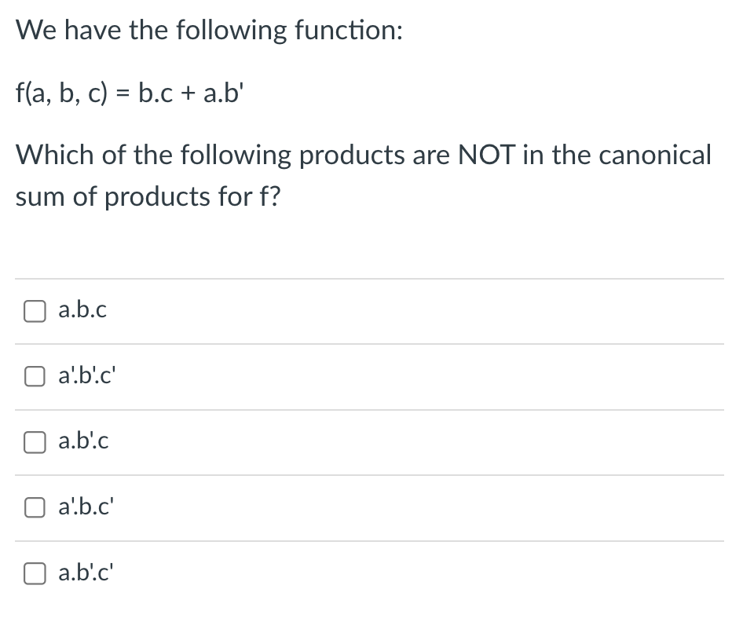
f(a, b, c) = b.c + a.b’
= 1.b.c + a.b’.1 (Identity)
= (a + a’).b.c + a.b’.(c+c’) (Complement)
= a.b.c + a’.b.c + a.b’.c + a.b’.c’ (Distributive)

Slide 45
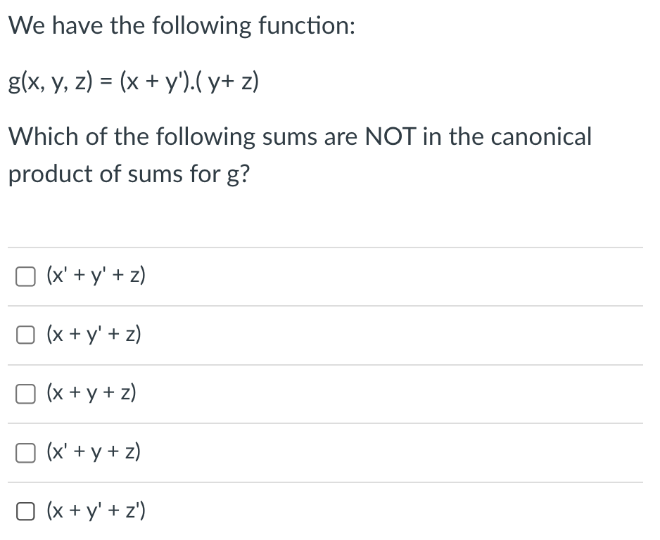
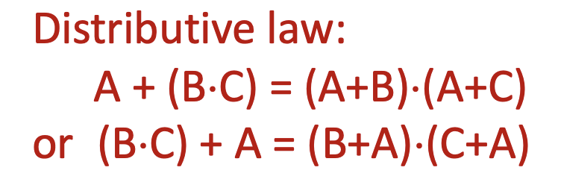
g(x, y, z) = (x + y’).(y + z)
= (x + y’ + 0).(0 + y + z) (Identity)
= (x + y’ + z.z’).(x.x’ + y + z) (Complement)
= (x + y’ + z)(x + y’ + z’).(x + y + z).(x’ + y + z)
(Distributive)

Slide 46
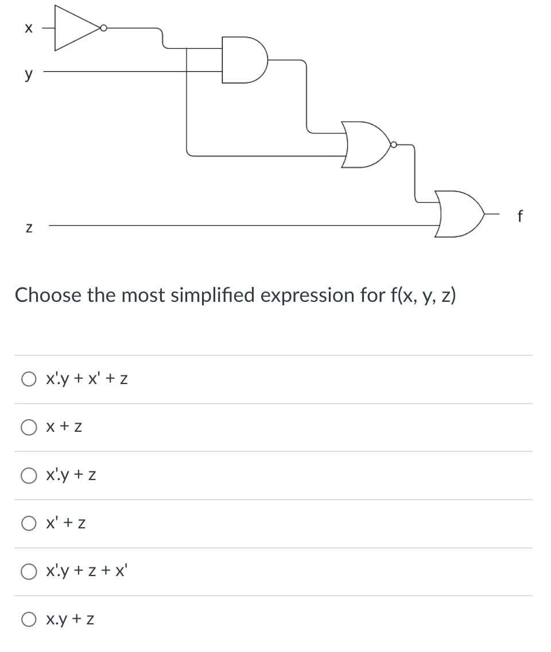
A
B
C
A = x’
B = A.y
= x’.y
C = (B + A)’
= (x’.y + x’)
f = (C + z)
= (x.y + x + z)
= (x + z) (Absorption 1)

Slide 47
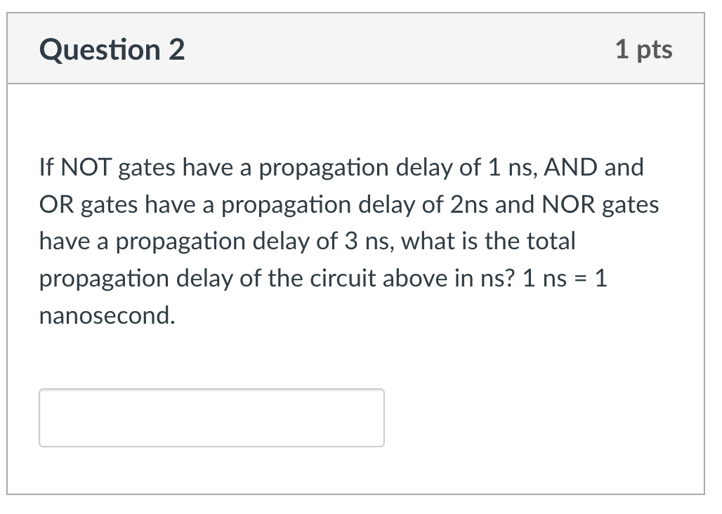

Slide 48
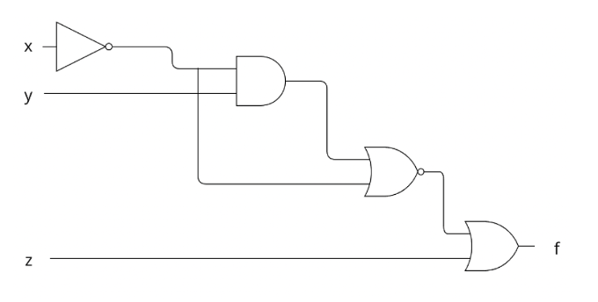
A
B
C
NOT: 1 ns, AND/OR: 2 ns NOR: 3 ns
Timing at A: 0 + 1 = 1 ns
Timing at B = max(y, A) + 2
= max(0, 1) + 2
= 3
Timing at C = max(A, B) + 3
= max(1, 3) + 3
= 6
Timing at f = max(C, z) + 2
= max(6, 0) + 2
= 8 ns

Slide 49
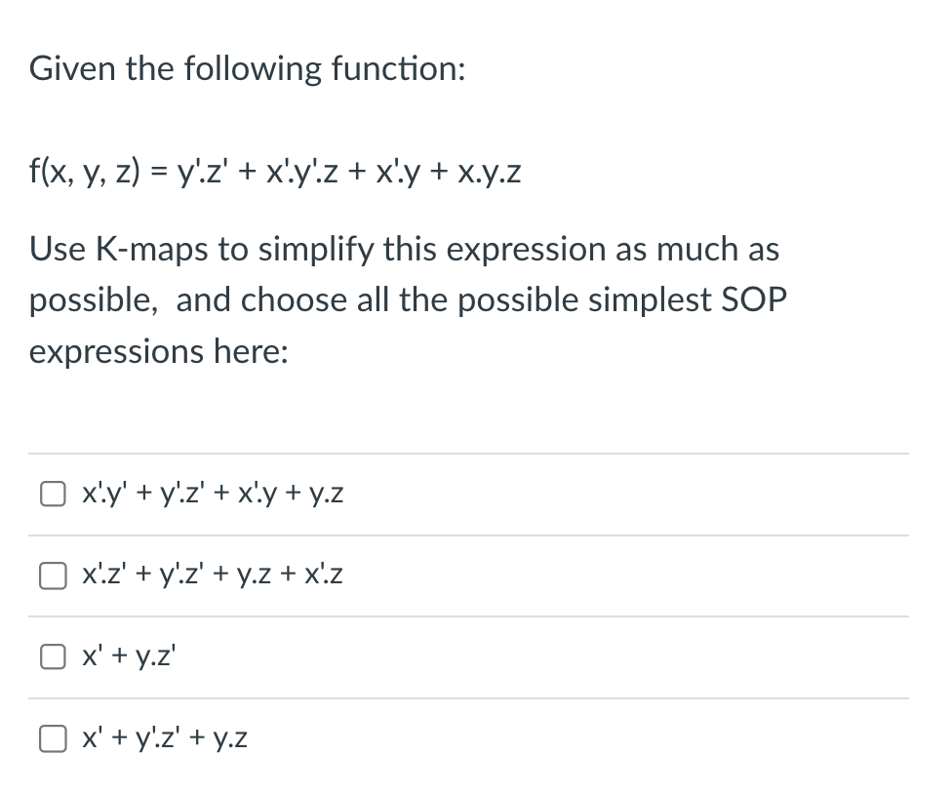

Slide 51
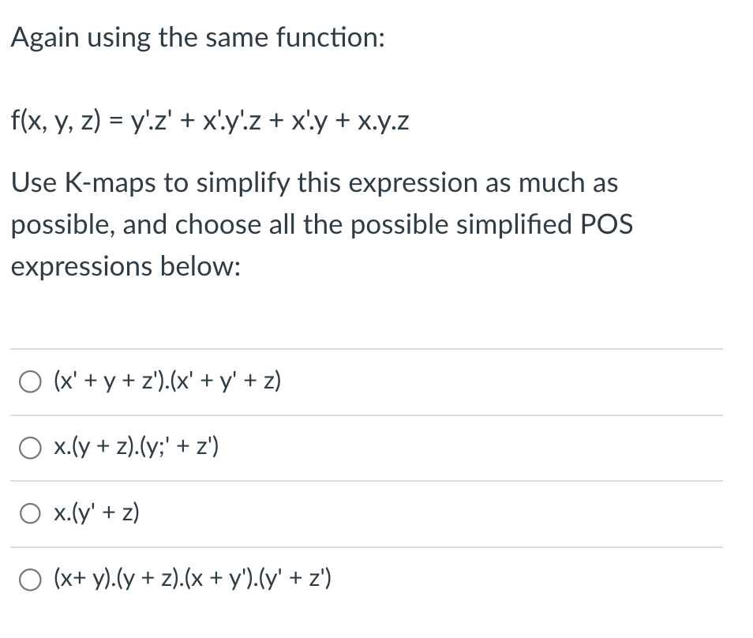

Slide 53
Sli.do questions

Slide 54
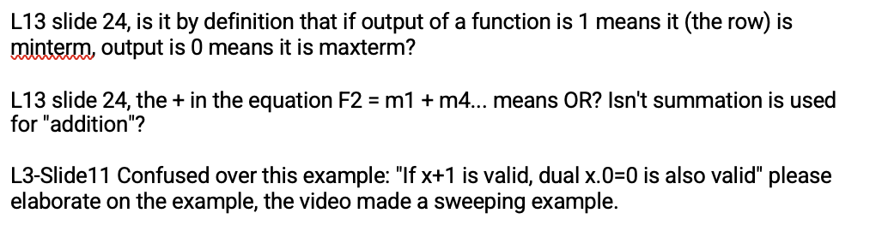
Slido Questions

Slide 55
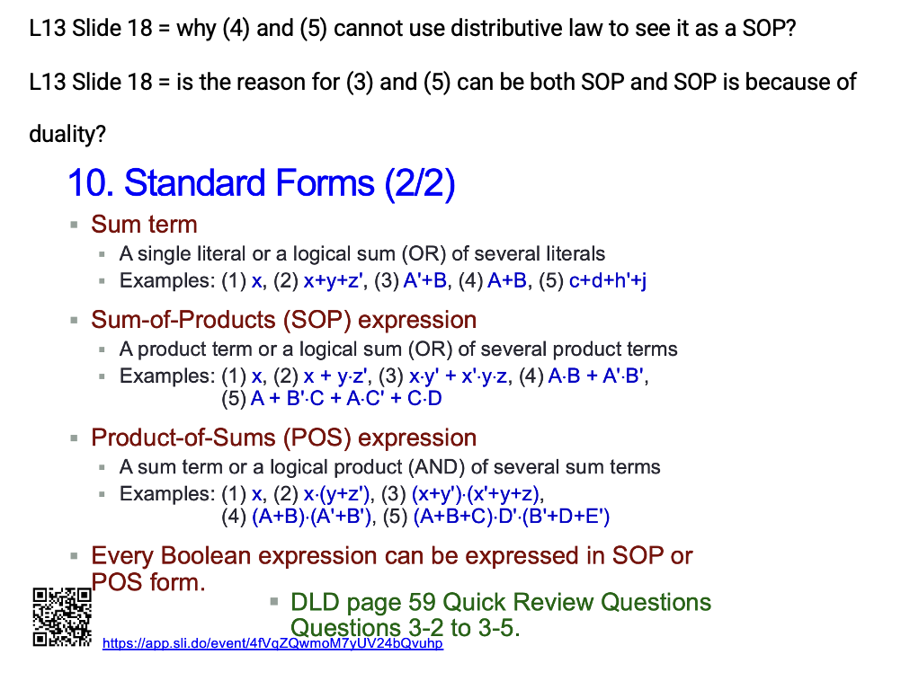
Slido Questions

Slide 56
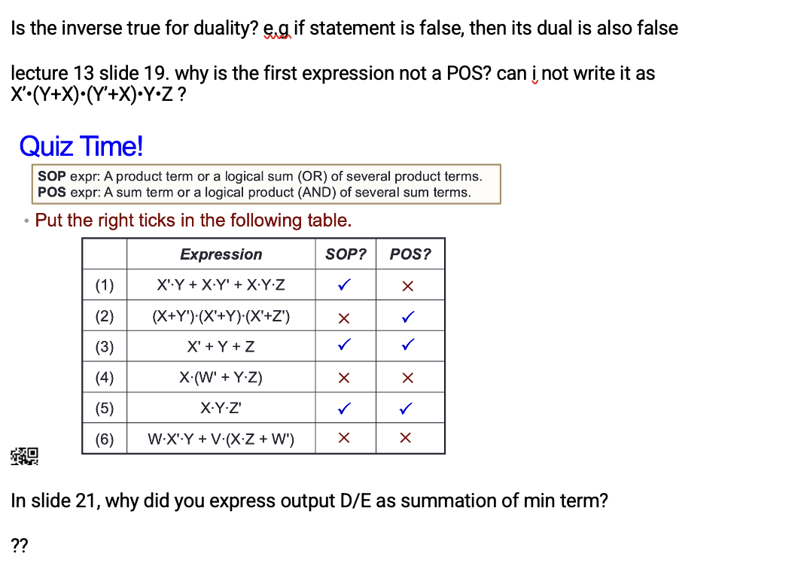
Slido Questions

Slide 57
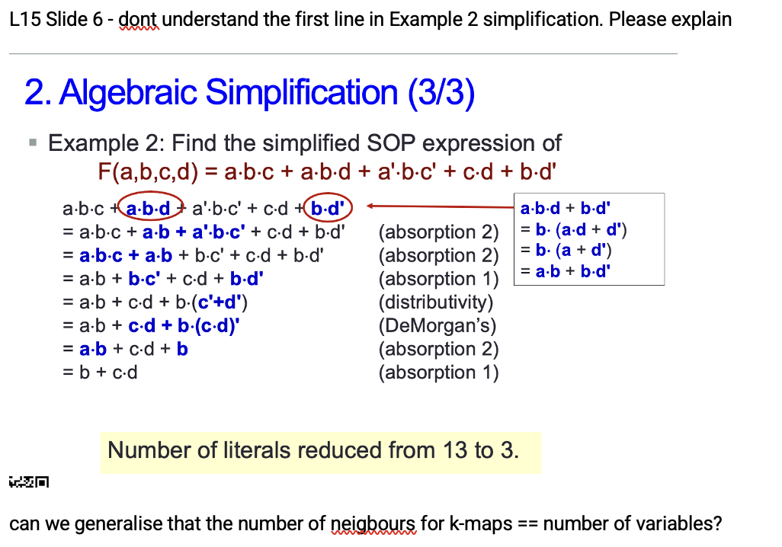
Slido Questions

Slide 58
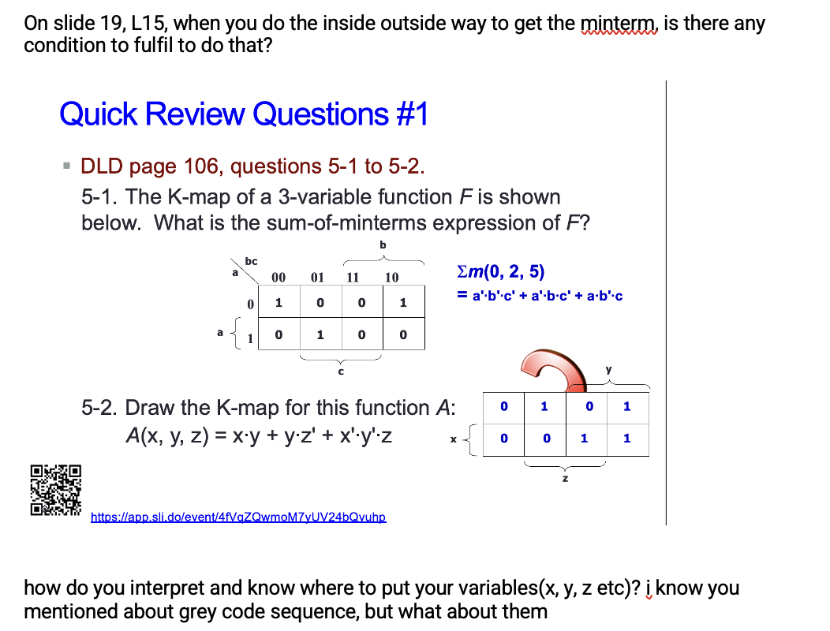
Slido Questions

Slide 59
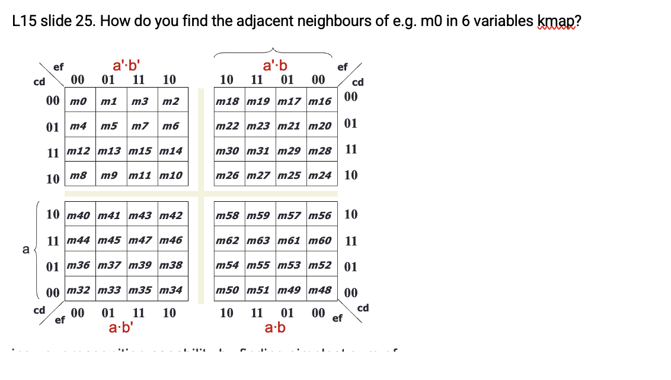
Slido Questions

Slide 60
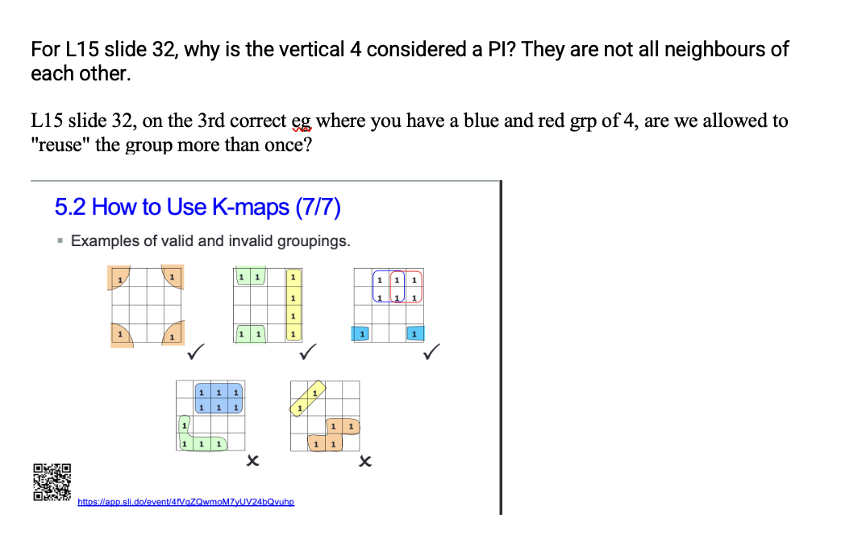
Slido Questions

Slide 61

Quick Review Questions #2
DLD page 106, question 5-3.
5-3. Identify the prime implicants and essential prime implicants of the two K-maps below.
How many PIs?
7 PIs
How many EPIs?
4 EPIs
b
A
bc
AB
a
00 01 11 10
CD
00 01 11 10
00
01
11
10
1
1
0
1
0
1
1
1
0
1
0
0
1
1
a
0
1
0
0
D
1
1
0
1
C
c
1
0
1
1
How many PIs?
3 PIs
B
How many EPIs?
2 EPIs


Slide 62
End of File

